Slide 1
ARTIFICIAL INTELLIGENCE IN WRITING: STUDENTS' VOICES AND WRITING COMPETENCES
by teguh sulistyo

Slide 2
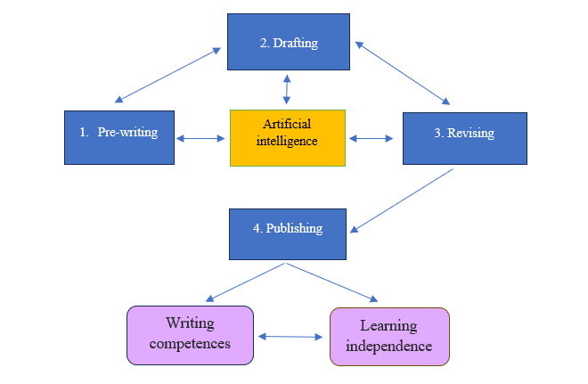
The integration of artificial intelligence and process-based approach in a writing class

Slide 3
Fostering Creativity and Critical Thinking
Divergent Thinking
Analytical Approaches
Personalized Challenges
Collaborative Ideation
AI-powered activities encourage students to explore multiple perspectives and generate novel ideas
Smart feedback and prompts from AI systems help students deconstruct complex writing tasks, boosting their critical analysis abilities.
Adaptive AI algorithms tailor writing activities to individual student needs, pushing them to minimize unnatural sentences/utterances.
AI-facilitated group projects encourage students to build on each other's ideas, fostering a creative, synergetic learning environment.

Slide 4
Pre-writing
Students try to find ideas of what they should write. With the help of AI, such as ChatGPT or Copilot, they can find the right vocabulary and ideas on how to develop their writing.
Enriching background knowledge
Developing learning independence

Slide 5
Drafting
Generating ideas they formulated in the pre-writing step. They maximize AI such as Quillbot, Deepl, and others to develop their text
Writing a rough draft

Slide 6
Revising
Leveraging AI for Personalized Feedback and Guidance
AI can now offer students highly tailored feedback and guidance on their work.
This personalized approach helps boost student engagement and motivation
Through natural language processing, students take ownership of their writing progress.

Slide 7
Publishing
Submitting the text to the teacher
Writing the final product

Slide 8
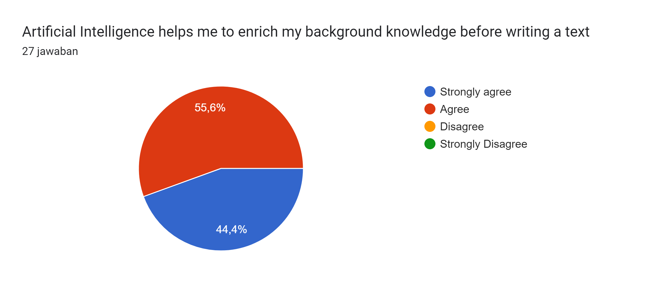

Slide 9
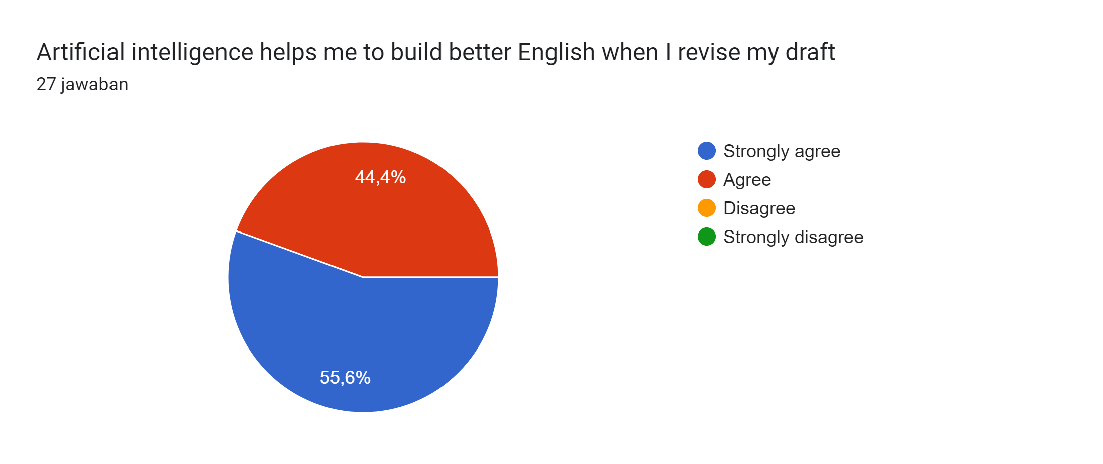

Slide 11
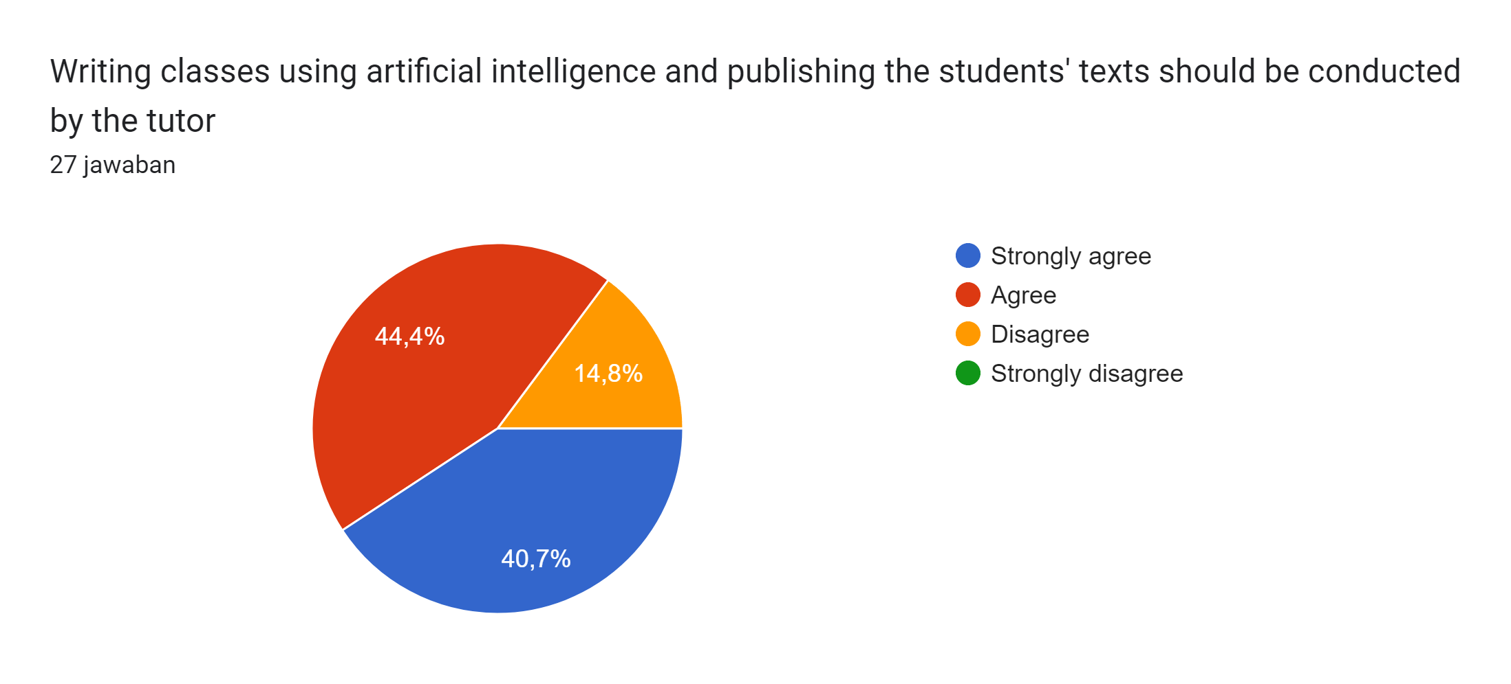

Slide 13
Students’ voices

Slide 14
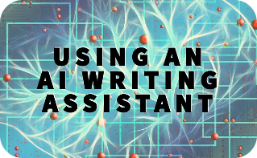
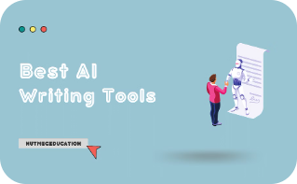
Integrating AI Tools into the Writing Curriculum
AI-Powered Writing Assistants
Curriculum Integration
AI Writing Workshops
Personalized AI Feedback
Incorporate AI-based writing assistants that provide real-time feedback, grammar corrections, and suggestions to help students improve their writing skills.
Seamlessly weave AI-driven writing activities and projects into the curriculum, enabling students to leverage AI tools to enhance their writing process.
Organize interactive workshops that teach students how to effectively use AI-powered writing tools, empowering them to become more self-sufficient writers.
Utilize AI to provide personalized, in-depth feedback on student writing, guiding them towards improvement and fostering a growth mindset.

Slide 15
Collaborative Writing Projects with AI-Driven Support
1
Brainstorming with AI
Utilize AI-powered ideation tools to help students generate creative writing prompts and explore diverse perspectives.
2
Collaborative Editing
Leverage AI-assisted feedback and revision features to facilitate peer review and iterative improvement of group writing projects.
3
AI-Powered Coordination
AI can help manage project timelines, assign tasks, and promote effective collaboration among student writing teams.

Slide 16
Gamification and AI-powered Writing Challenges
Writing Quests
Leaderboards
Leverage AI to create engaging writing challenges that guide students through creative storytelling tasks and narrative building exercises.
Implement AI-powered leaderboards that track student progress and highlight top-performing writers, fostering healthy competition.
Adaptive Difficulty
AI Writing Coaches
Use AI to dynamically adjust the complexity of writing prompts based on individual student abilities, ensuring an optimal challenge level.
Provide students with AI-driven writing coaches that offer real-time feedback and suggestions to improve their skills.

Slide 17
Improving writing skills through AI-assisted revision
Identify weaknesses
AI can analyze your writing and pinpoint areas for improvement, such as grammar, sentence structure, and word choice.
Receive personalized feedback
AI-powered writing assistants can provide tailored suggestions to help strengthen your writing skills and address specific challenges.
Implement revisions
Use AI tools to implement revisions and refine your writing. Track changes, experiment with alternatives, and polish your work.

Slide 18
Measuring student engagement and learning outcomes
Student
Improvement
Independence learning
in Writing Skills (complexity, accuracy, and fluency)
By leveraging AI-powered analytics, instructors can precisely measure student engagement and the impact of project-based learning activities on writing skill development.

Slide 19
Conclusion and future directions for AI in writing education
Embrace the AI revolution
Continuous innovation
AI holds immense potential to revolutionize writing education, transforming how students engage, learn, and improve their skills.
As AI technology advances, new applications and possibilities will emerge, empowering educators to create even more dynamic and personalized writing experiences.
Collaborative human-AI synergy
Ethical AI implementation
The future lies in seamless integration of AI tools and human instruction, fostering a collaborative ecosystem that brings out the best in both.
Responsible and ethical deployment of AI in writing education will be crucial, ensuring equitable access and protecting student privacy and well-being.

Slide 20
Thank you
AI makes it easier for students to write better. A process-based approach helps students organise their ideas into a text.

