Slide 1
Integrating Cultural Awareness of students into Authentic Learning : Teachers experiences and challenges
Dr. Delli Sabudu, S.Pd., M.A

Slide 2
INTRODUCTION
Cultural understanding is a basis for competence-oriented general education especially connected to the students’ cultural awareness in authentic learning. Teachers are responsible for applied content and methods that are used to purposefully lead school students to that result.

Slide 3
CONTINUE
Understanding cultural issues is important in current education. For example, it is declared by UNESCO as one of the key competences for lifelong learning, or as a result of competence-oriented education. In education different concepts related to the learning culture are used - cultural awareness (sensitivity to the similarities and differences that exist between different cultures and the use of this sensitivity in an effective way), cultural competence (the ability to participate ethically and effectively in personal and professional intercultural settings), cultural literacy (the ability to understand and participate fluently in a given culture, critically reflect on, and if necessary bring changes in it). In this study, the term cultural understanding (the knowledge and understanding of experiences with one’s own culture as well as others’ cultures that inform one’s ability to navigate new experiences) is used, because it is the most common in Manadonesse tradition. The teacher is an agent for implementing the purposeful development of junior high school students’ cultural understanding and awareness in actual school life.

Slide 4
WHY ?
So it may be said that cultural awareness is one of the important aspects of education according to UNESCO. Cultural awareness means sensitivity to the similarities and differences that exist between different cultures and the use of this sensitivity in an effective way
Students with the same cultural background will interact more easily than those with different backgrounds,
Teachers with students who have the same background will also interact and connect more easily
And even teachers with the same background will be easy to interact with,
The conditions like this often cause discomfort in the learning environment so cultural awareness needs to be raised and increased, especially in authentic learning where this learning involves more things that are actual and relevant to the lives of students and teachers.

Slide 5
AIMS :
The aim of this study is to identify actual goals for the development of teacher education curriculum, professional development and teaching aids by investigating in-service teacher’s challenges for the successful promotion of students’ cultural understanding focus on students’ cultural awareness in Junior high school.
To meet the aim, 8 Moslems teachers in MTS Negeri I Manado and 8 teachers from State Junior high schools were asked to complete the data. Qualitative analysis of the data was performed to clarify their practices, beliefs and professional needs related to the problem.

Slide 6
RESULT
The result showed that teachers are aware of the significance of personally meaningful learning for students and the importance of a positive atmosphere in the classroom. Their experiences of integrating the cultural issues in all school subjects and connecting the learning with actual situations and socio-cultural contexts life are at a much lower level (in the context of authentic learning) . A similar situation is with teachers’ experiences with the content of culture – they mostly interpret culture as belonging to art, rather than all human expression.
The data revealed a difference between educators’ beliefs and knowledge – and their real practices:
Teachers note the importance of active and self-directed learning, but common expressions that students are not motivated to show that it is not implemented effectively in practice.
Teachers recognize the need to foster the development of contextual learning but do not dare to plan and implement the learning process independently and creatively.
Teachers cultivate a positive atmosphere in the classroom but do not feel responsible for creating one outside the classroom, in collaboration with colleagues and school management.
It can be argued that there is a gap between what teachers think they know and do to achieve a transformative learning process and their real competence to implement it in practice.

Slide 7
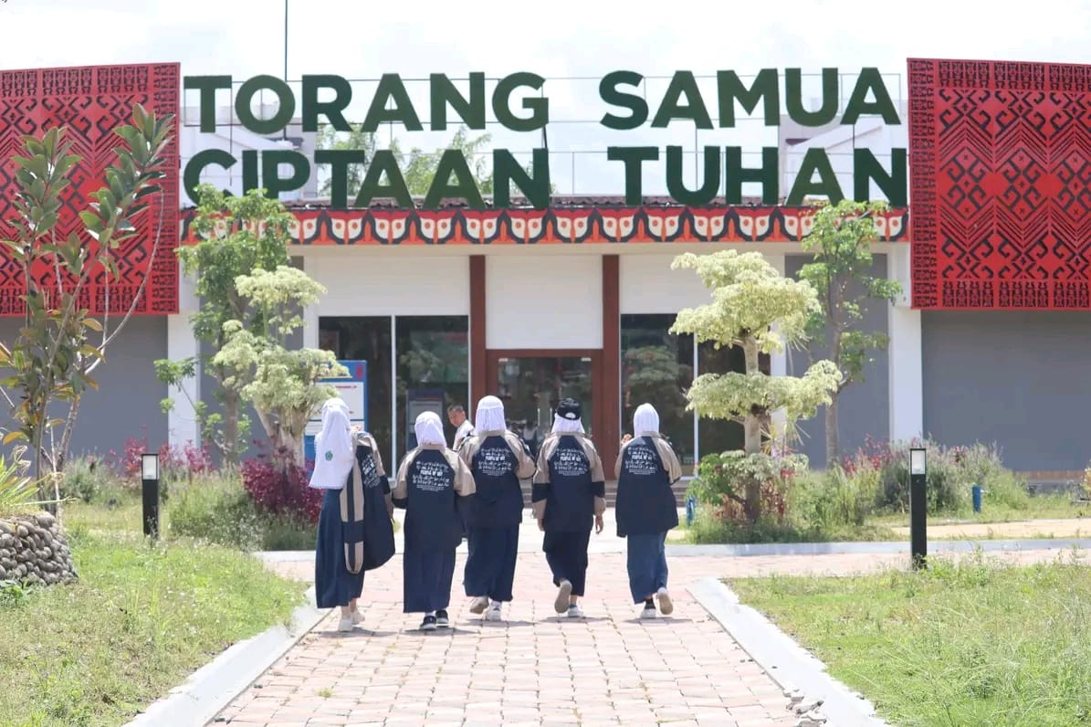

Slide 8
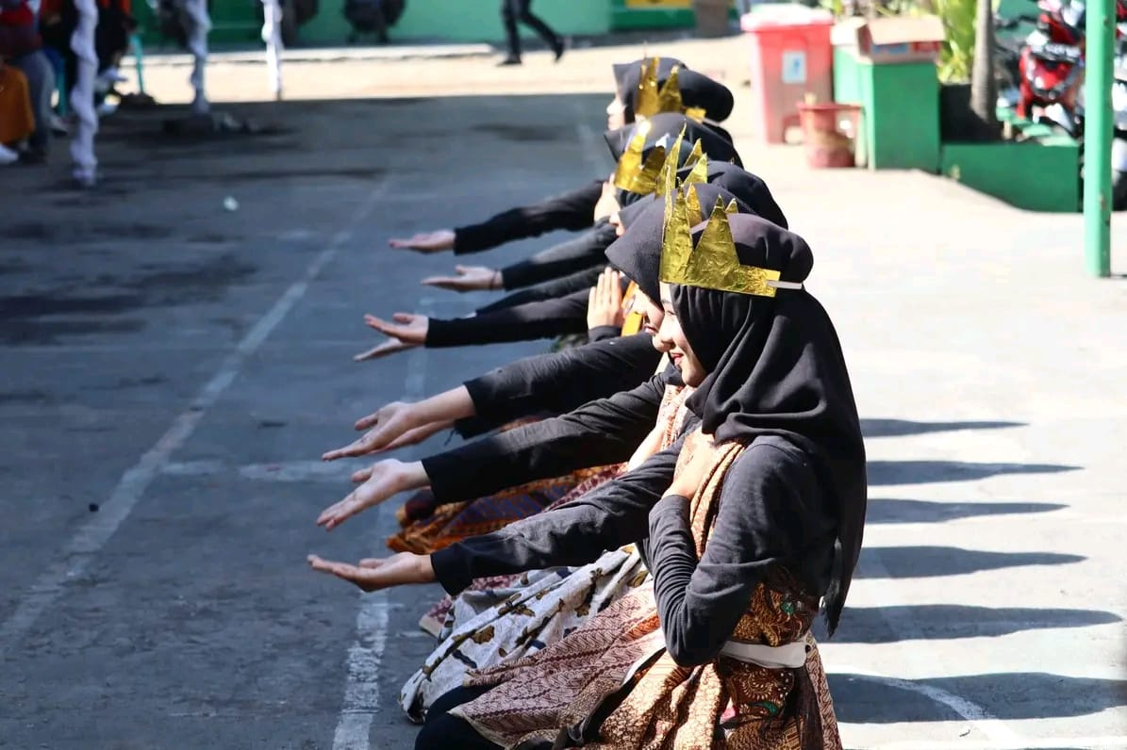

Slide 9
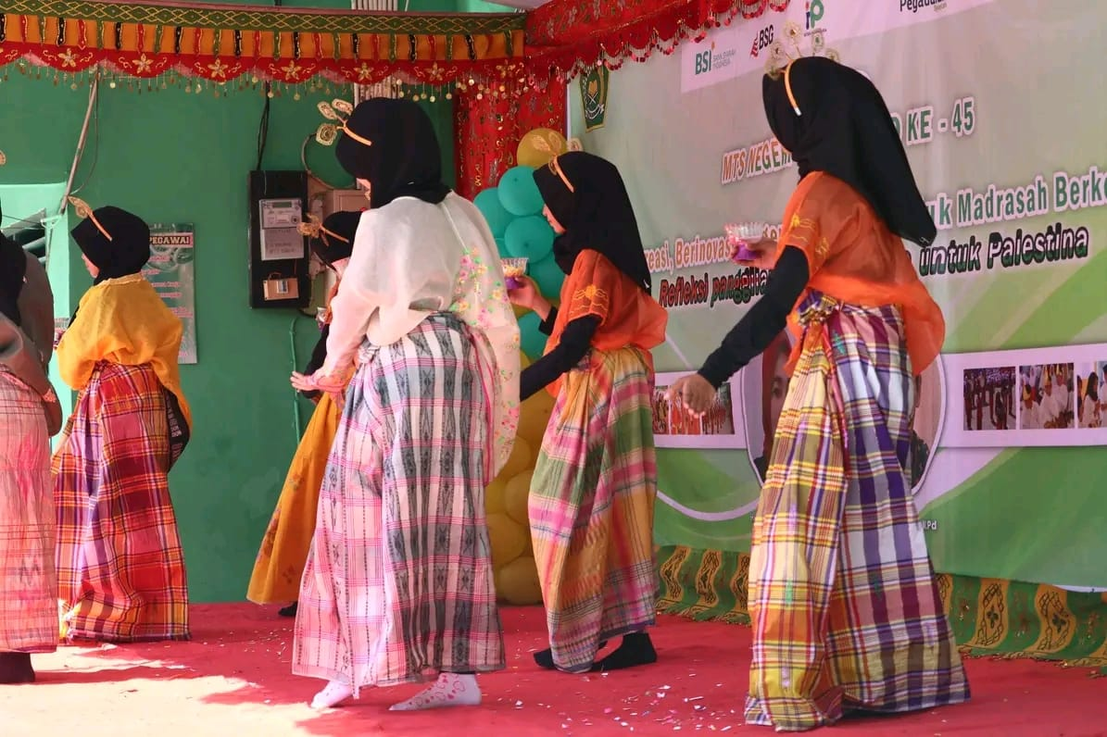

Slide 10
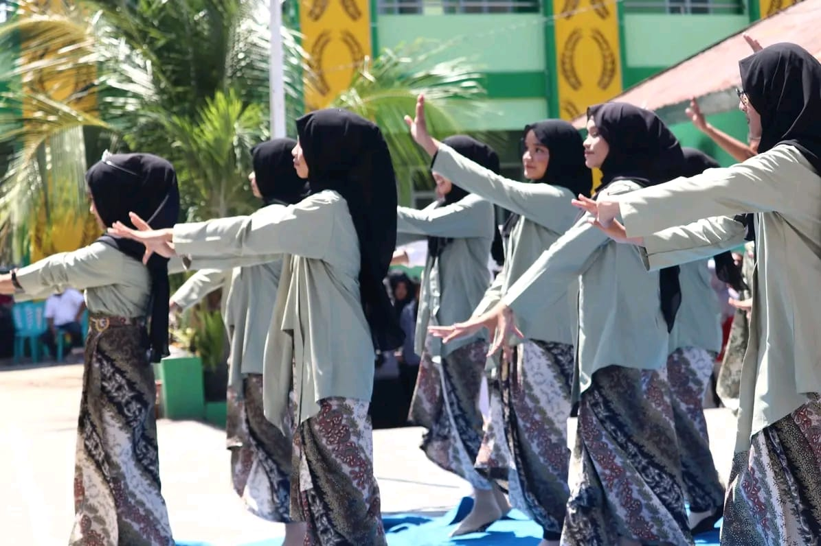

Slide 11
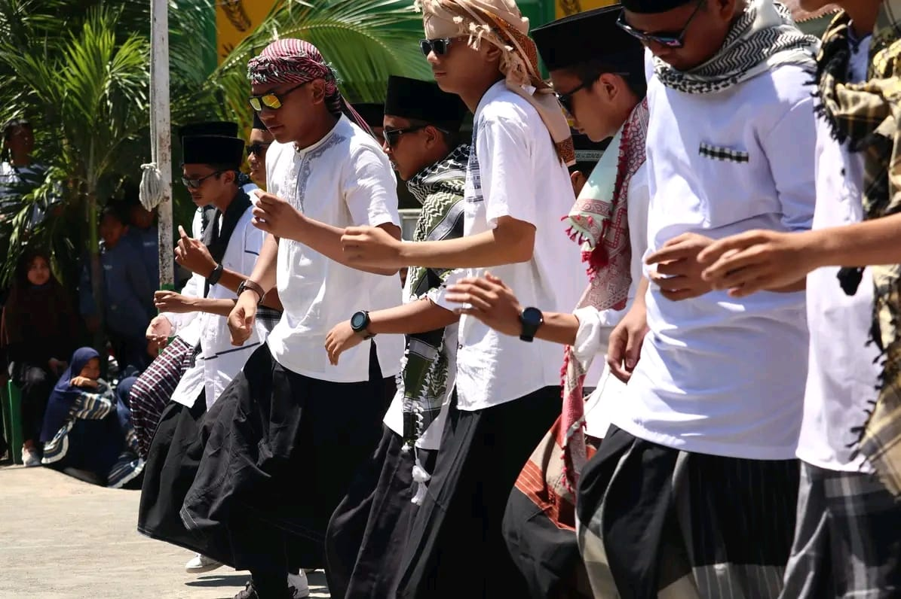

Slide 12
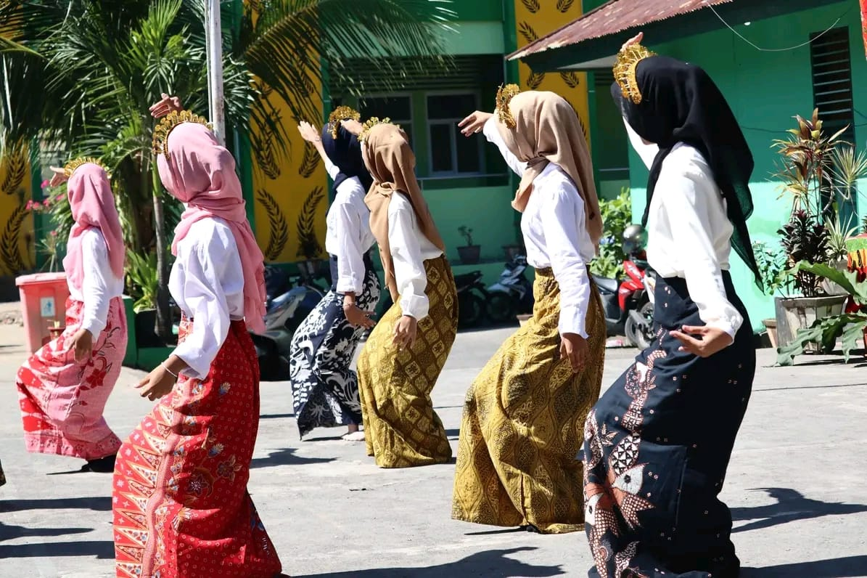

Slide 13
DISCUSSION
Respondents' practice can be interpreted as a traditional transmissive approach to promoting students’ cultural awareness. Teacher educators face a challenge in upgrading the teacher education curriculum, professional development, and teaching aids to reduce the gap between theoretical principles of transformative learning and teachers’ beliefs and practices related to promoting general school students’ cultural understanding.
Possible solutions:
To realize inter- and trans-disciplinary studies in teacher education by purposeful integration of cultural issues
and discussions about contradictory values in all study courses, not only in arts, language, and social sciences.
2. To promote the prospective teacher’s cultural understanding through reflecting on personal experiences,
involving the students in setting individual learning goals, as well as discussing the different meanings and
cultural values that help the appreciation of the cultural context and the diversity of people’s experiences.
3. To encourage the openness and creativity of future teachers by suggesting that they create and share with
other students some original materials, like catalogs of lesson ideas or support materials
for the organization of Junior High school students’ personally meaningful learning, linking them with their life experiences
and authentic life events.
4. To cultivate a trustful, honest, straightforward, and respectful atmosphere in the Classroom.

Slide 14
CONCLUSION
In conclusion, it can be claimed that this research indicated aspects that teachers consider relevant as well as the main problems and gaps between theoretical principles recognized as essential by educational policy, and teachers’ beliefs and practices. Cultural awareness in authentic learning activity needs to be implemented well into practice so the learning purposes can be optimized achieved

