Slide 1
Good luck for international webinar

Slide 2
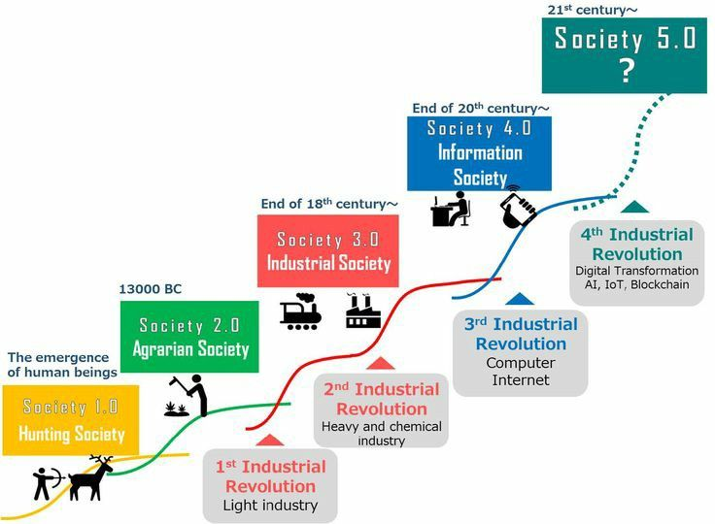

Slide 5
Integrating ELT in the flipped classroom
Abdullah Farih
Islamic University of Lamongan

Slide 6
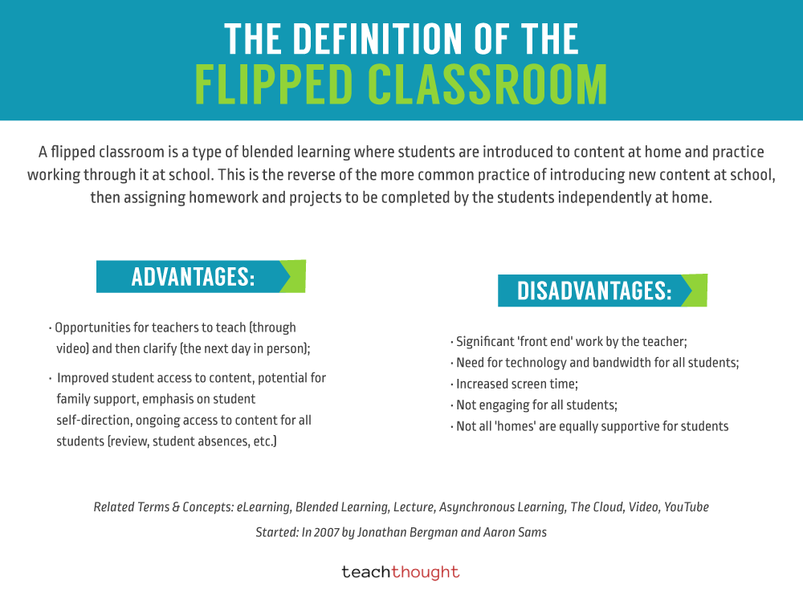

Slide 7
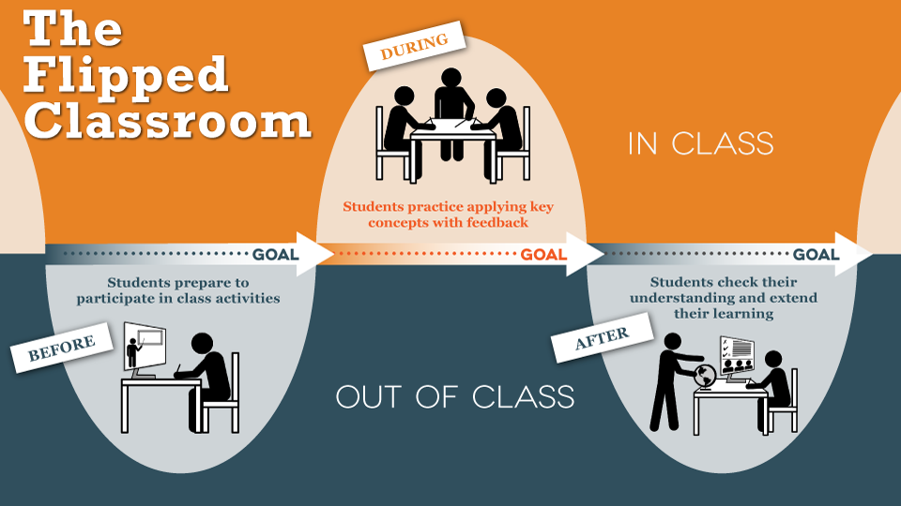

Slide 8
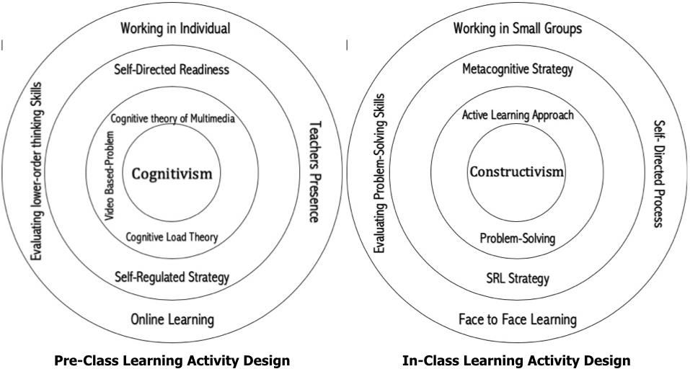

Slide 9
pre-class learning activities
Organizing pre-class learning activities to support communication knowledge effectively acquired by students is the major goal of this part. Thus, for completing pre-class learning tasks, teachers must consider cognitivist learning theory (first circle) as a foundation to design a whole instructional activity.
Suggests that before creating video based-problems, cognitive theory of multimedia and cognitive load theory become fundamental considerations to produce a video based-problem that appropriate with the students’ needs.
Suggests encouraging the students to use their self-directed readiness to regulate their time management, self-efficacy, and metacognitive as well as help seeking strategy.
The last circle suggests that when a student works individually at home, the teachers’ presence in online learning activity is a necessary. For example, teachers not only can scaffold students who need their help, but they also can evaluate the students’ lower order thinking skills

Slide 10
in-class learning activities
Organizing in-class learning activities to facilitate individual knowledge construction and create meaningful experiences to engage the students is the major goal of this part. Thus, for completing in-class learning tasks, teachers must consider constructivist learning theory (first circle) as a foundation to design the whole instructional activities.
The second circle suggests devoting active-learning approach during in-class time such a problem-solving activity.
The third circle suggests encouraging the students to use their self-regulated learning strategy such as planning, monitoring, evaluation the problem-solving activities (metacognitive skills).
The last circle suggests that despite the students work in a small group in face to face interaction, the instructional must accommodate the self-directed process. It means that, every student should engage in self-directed learning activities to propose their point of view to the problems.
Additionally, the teachers should evaluate students’ higher order thinking skills such a problem-solving skill.

Slide 11
Pre-class learning tasks
Conclusion
Teachers must be aware of cognitivist learning theory,
cognitive theory of multimedia, and
cognitive load theory to become fundamental considerations to produce a video-based problem that appropriate with the students’ needs.
Encourage students to use their self-directed readiness to regulate their time management and self-efficacy.
When a student works individually at home, the teachers’ presence in the online learning activity is necessary to evaluate the students’ lower order thinking skills.

Slide 12
In-class learning tasks
Teachers must consider constructivist learning theory as a foundation to design a whole instructional activity.
Devoting an active-learning approach during an in-class time such a problem-solving activity.
Encouraging the students to use their self-regulated learning strategy such as planning, monitoring, evaluating the problem-solving activities (metacognitive skills).
Despite the students collaborate as a group in a face to face interaction, the instructional must be a self-directed process. It means that every student in the group should be encouraged to use their self-directed skills to propose their point of view to the problems.
The teachers should evaluate students’ higher order thinking skills such a problem-solving skill.

Slide 13
Thank you

