Slide 1
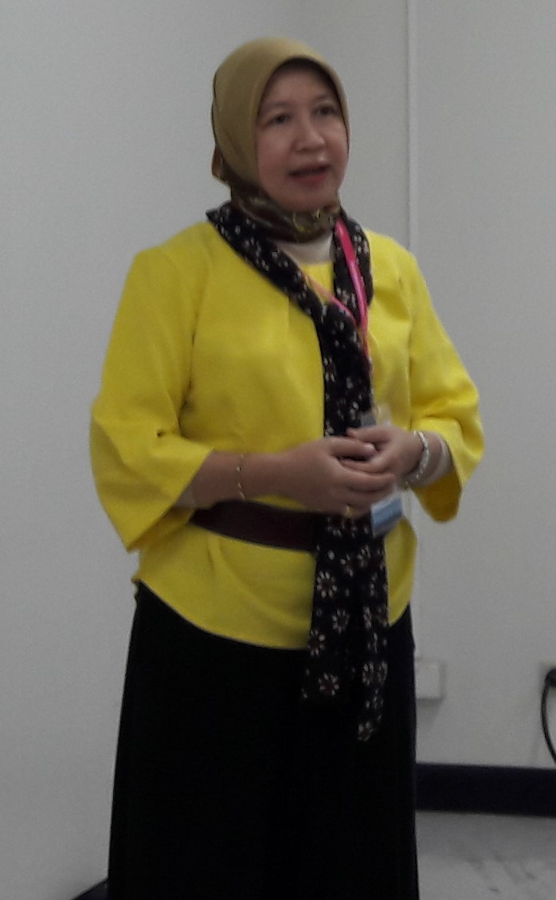
Mentimeter as an option to encourage students’ creativity in online learning Rachmi, M.Pd STIT Misbahul Ulum Gumawang

Slide 2
TEACHING WITH TECHNOLOGY WHY?
Dr. C. Terry Morrow, 1995
The benefits of using technology
It enhances curriculum
It increases flexibility of the presentation
It improves lectures
It provides visualization in a variety of formats

Slide 3
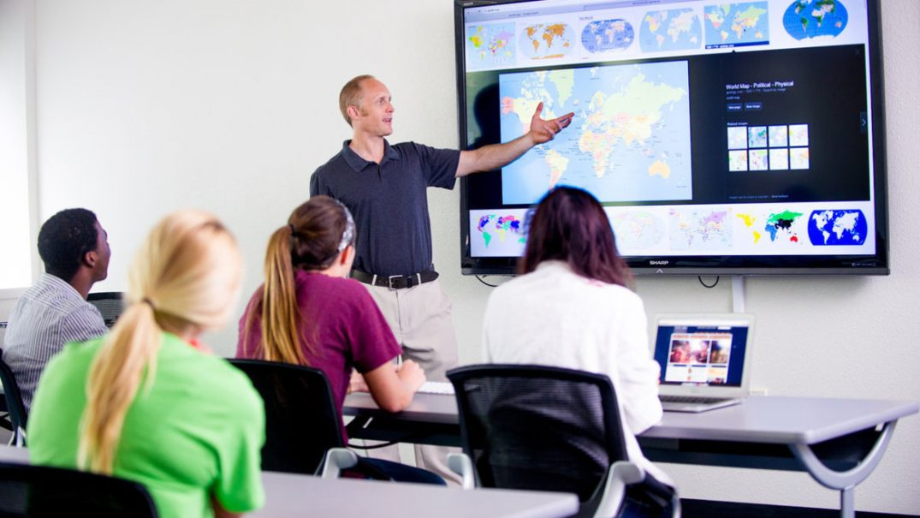
TEACHING WITH TECHNOLOGY
source: googleimages

Slide 4
TEACHING WITH TECHNOLOGY

Slide 5
TEACHING WITH TECHNOLOGY
Richards, 2014
“The use of technology in teaching becomes more important in present times, because teachers also have to be able to keep up with the technological knowledge of their students”
Prensky, 2001
in order to meet the expectations of today’s ‘digital natives’, who are quite competent, and in a way, dependent to computers and other online instruments technology is expected to help students to get better understanding on their lesson.

Slide 6
Technology in EFL classroom
Alsied & Pathan, 2013
The use of technology for teaching, learning, practicing and assessing foreign language has many advantages, particularly in the English as a Foreign Language (EFL) contexts where learners have very few opportunities to practice and assess their language skills.
Günüç & Kuzu, 2014
The use of technology in instructional activities also plays an essential role for engaging students in learning;

Slide 7
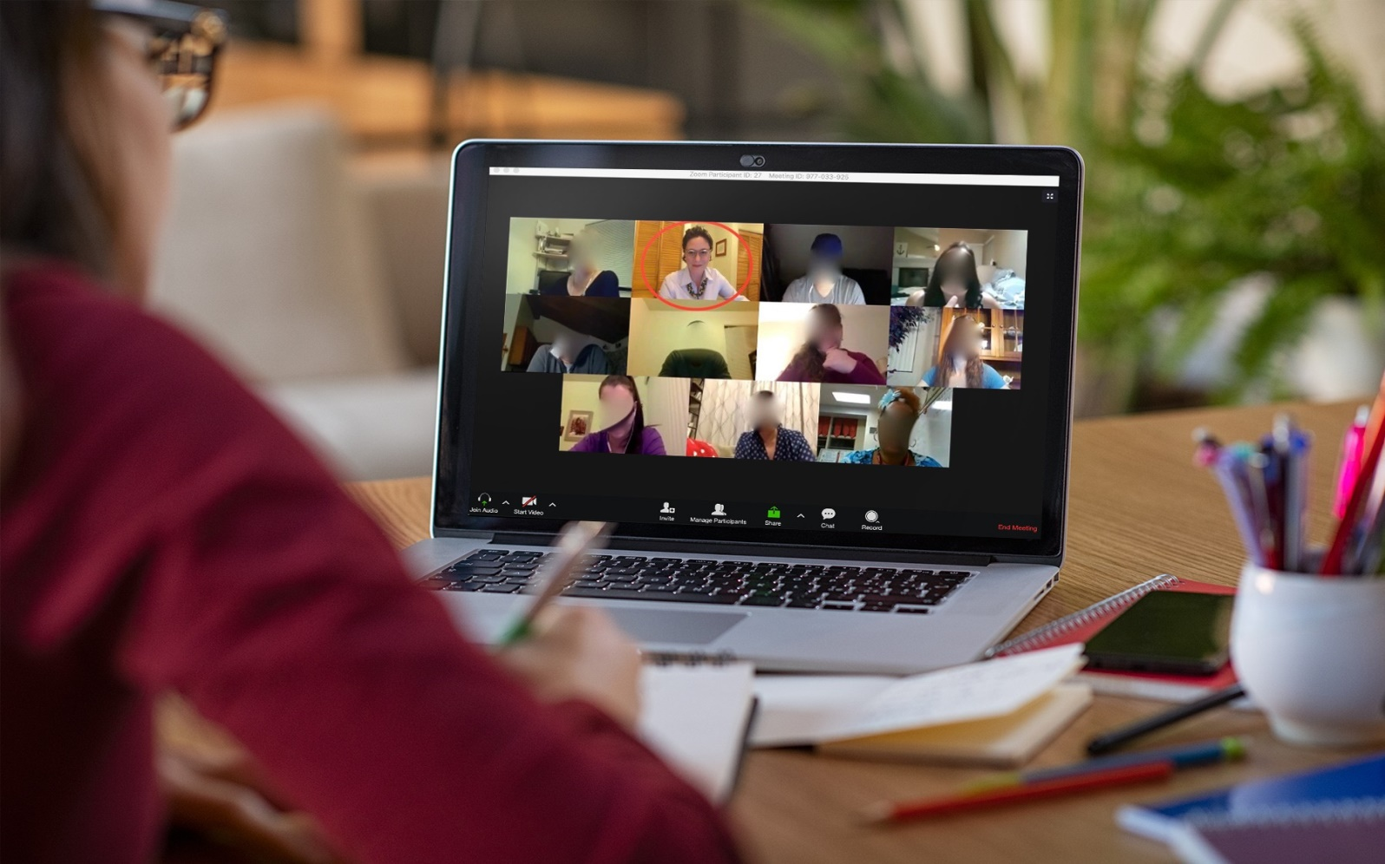
Online learning in the pandemic Covid-19
SOURCE: GOOGLE IMAGES

Slide 8
Online learning in the pandemic Covid-19
source: google images

Slide 9
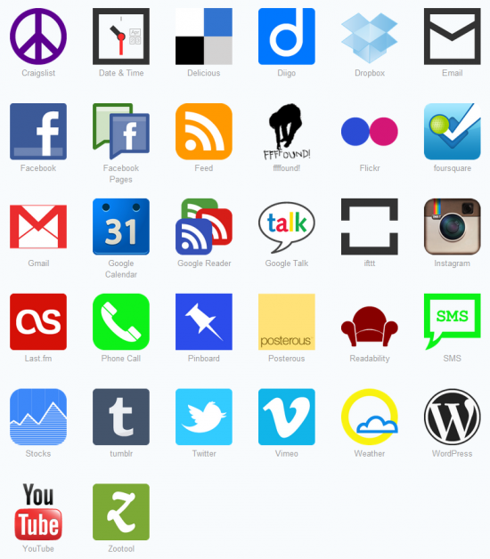
Web 2.0 Tools
Initiated by O’Reilly Media in 2003

Slide 10
Integrating web 2.0 tools in classroom
Gokbulut, 2020
In the digital age, where technology is developing rapidly, there is a need for technology and game-based e-learning environments that students appreciate instead of traditional instruction. Interactive Web 2.0 tools can be utilized to develop e-learning environments

Slide 11
Integrating web 2.0 tools in classroom
Ebner, 2007 While Web 1.0 enabled users to browse or search on the internet to read static content created by “experts”
McLaughlin & Lee, 2007 Web 2.0 tools provided the users with the option to write, post and interact on the web. Users have become authors, contributors, editors or “experts” of their own writing, and can now consume, create and edit content themselves by collaborating with other users

Slide 12
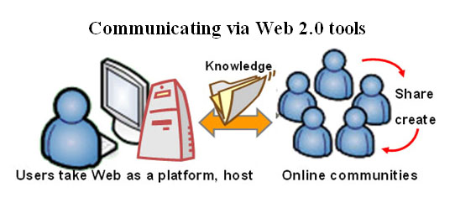
Integrating web 2.0 tools in classroom
Created by Shen-Yu Hwang(2007

Slide 13
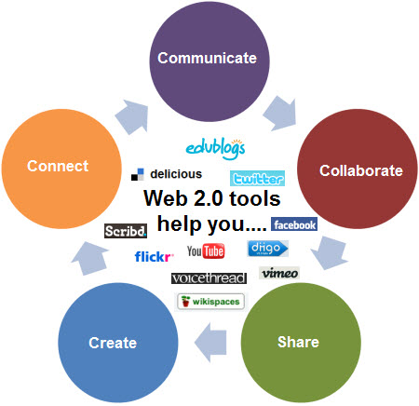
Integrating web 2.0 tools in classroom
Source: Bodi’s wiki

Slide 14
Integrating web 2.0 tools in language classroom
Chartland, 2012
Web 2.0 tools is beneficial in creating students’ interactivity and raising their potential to produce meaningful output. As learners will find language classrooms more enjoyable with the integration of Web 2.0 tools, they will be more involved in the language learning process, which consequently increases their motivation.

Slide 15
MENTIMETER
is one of Web 2.0 tools
is a student response system (SRS) or an Audience Response system (ARS)
is freemium (i.e. free and premium versions are available)
no extra hardware (apart from the standard laptop, projector and students’ own digital devices) are needed
cloud-based and opensource
Can be utilized during zoom/google classroom meeting

Slide 16
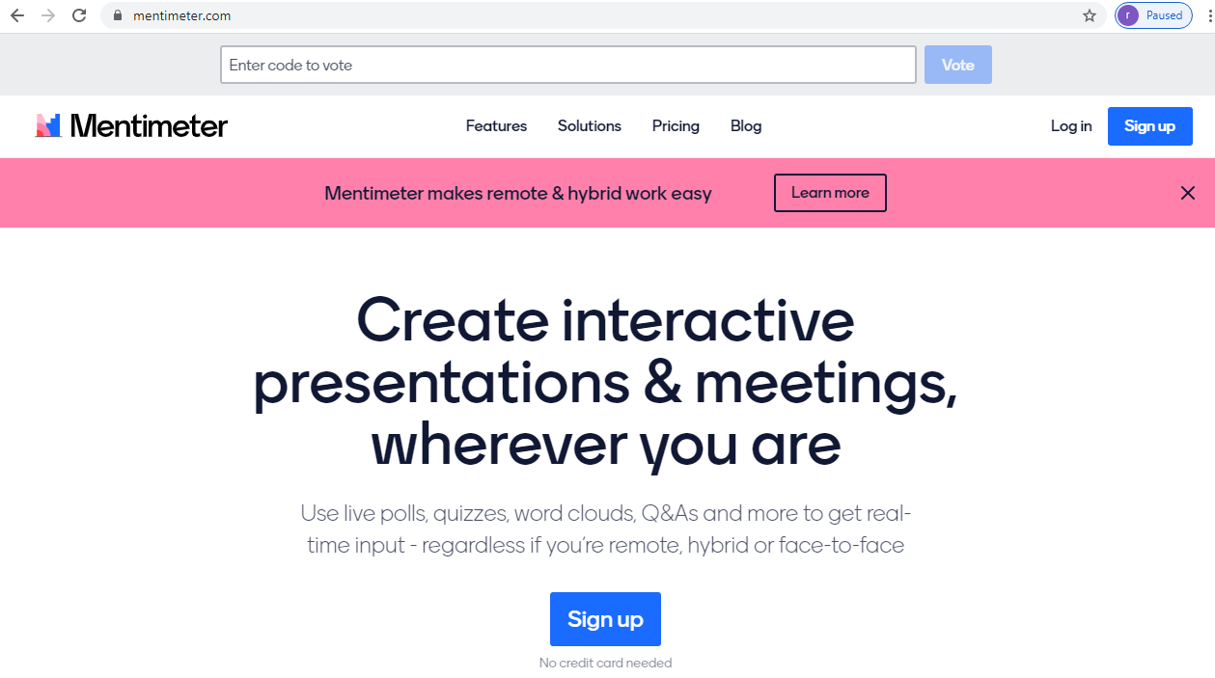
MENTIMETER

Slide 17
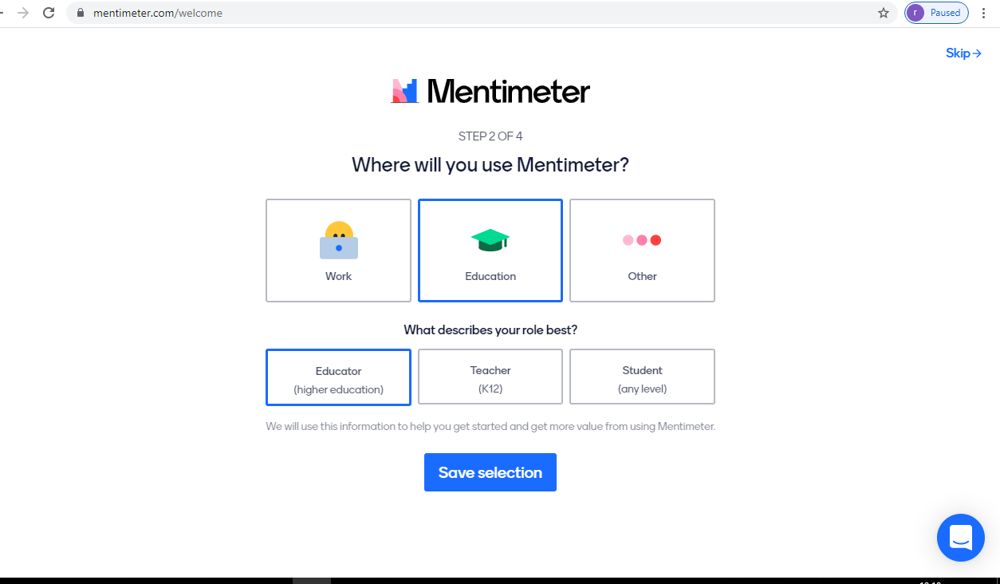
MENTIMETER

Slide 18
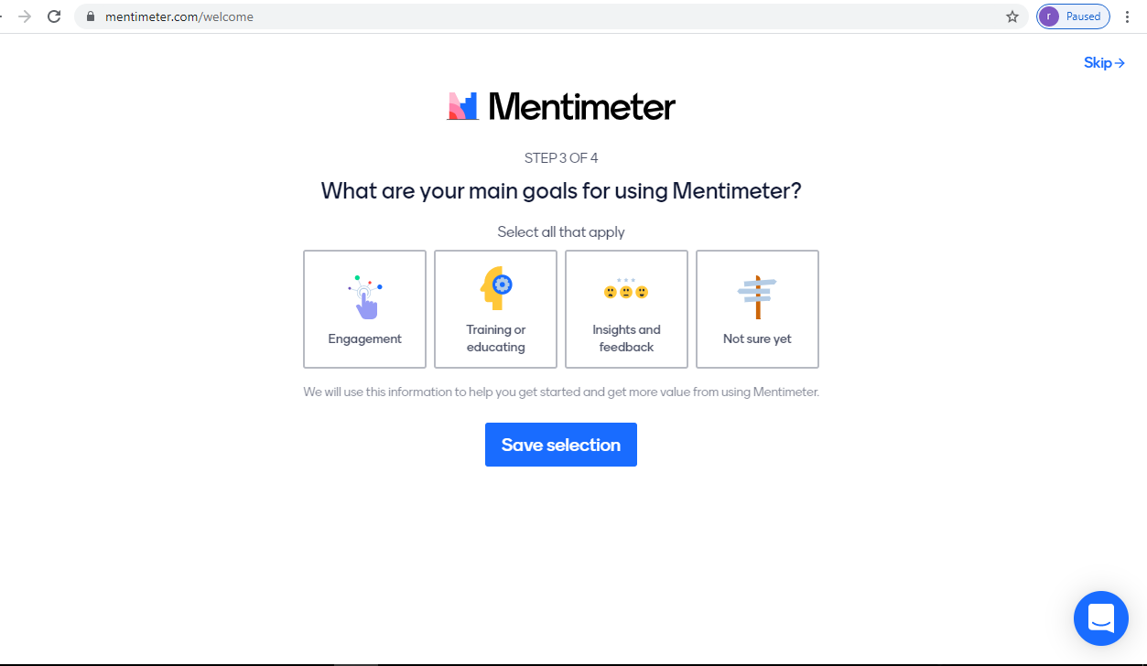
MENTIMETER

Slide 19
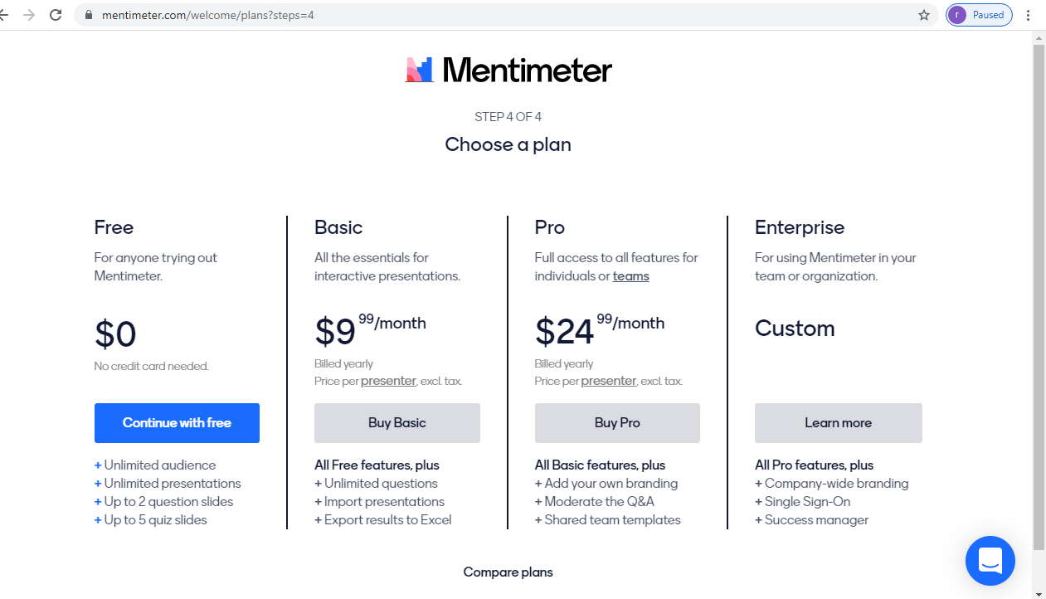
MENTIMETER

Slide 20
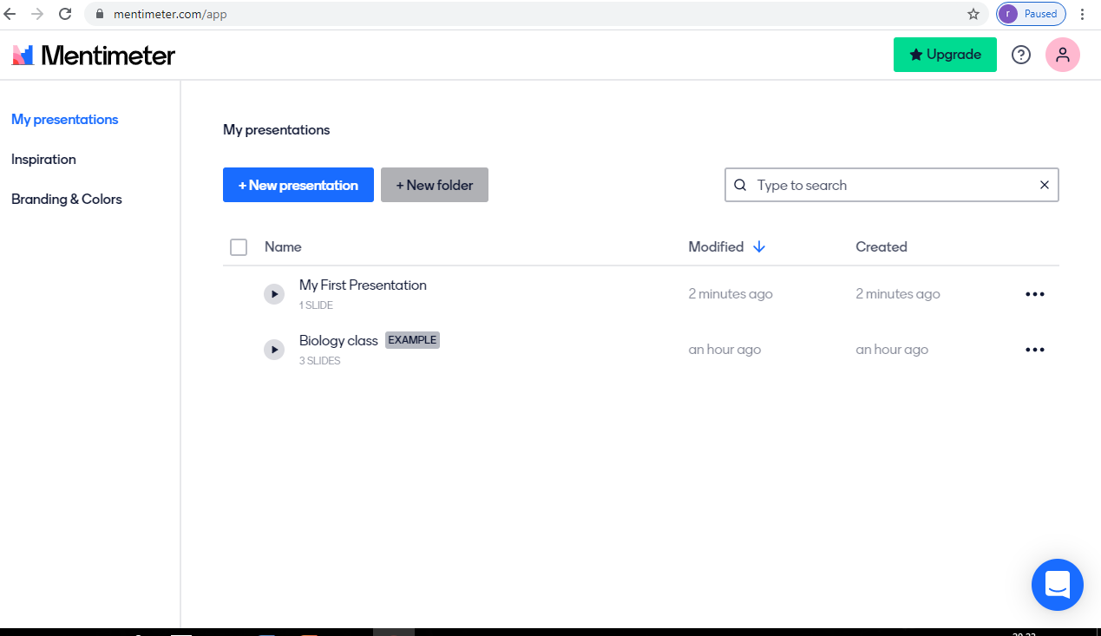
MENTIMETER

Slide 21
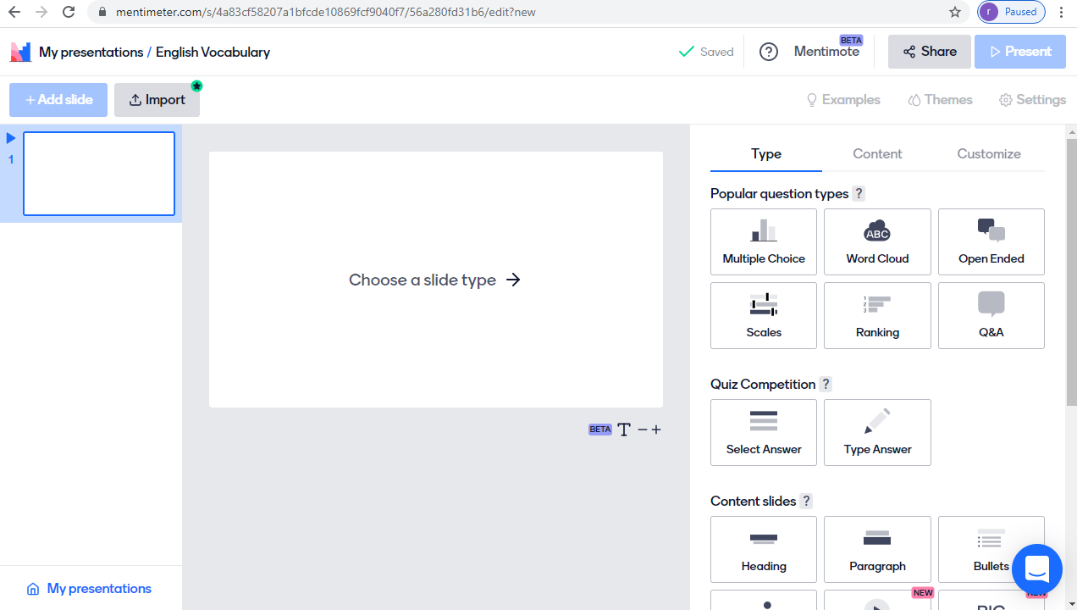
MENTIMETER

Slide 22
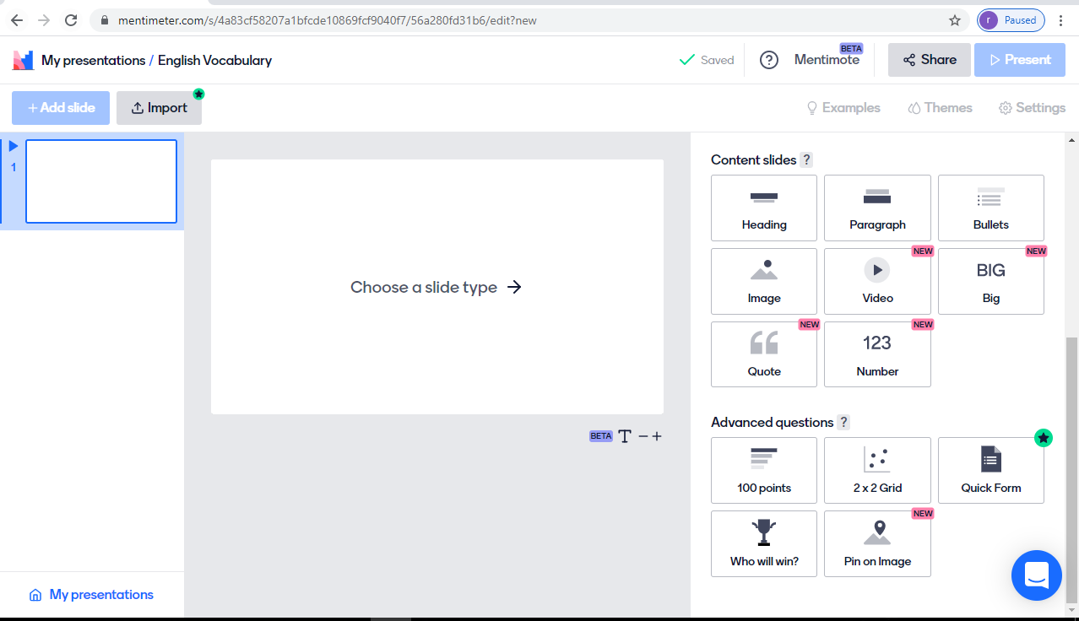
MENTIMETER

Slide 23
MENTIMETER

Slide 24
MENTIMETER

Slide 25
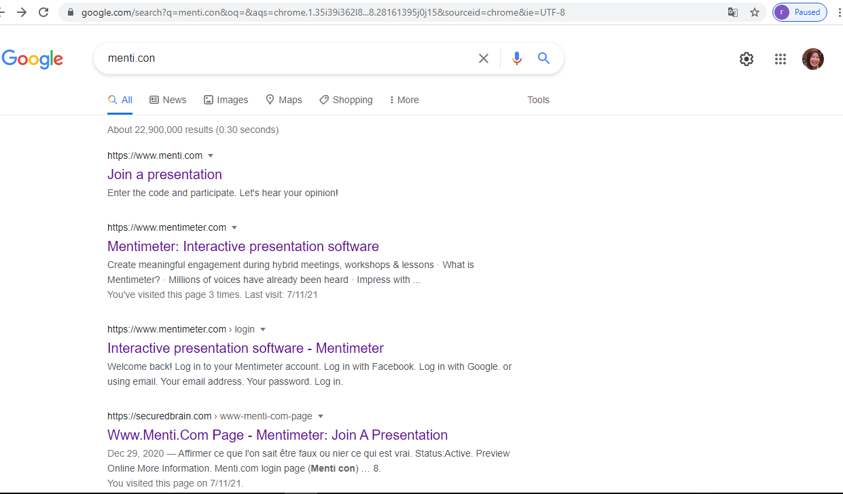
MENTIMETER

Slide 26
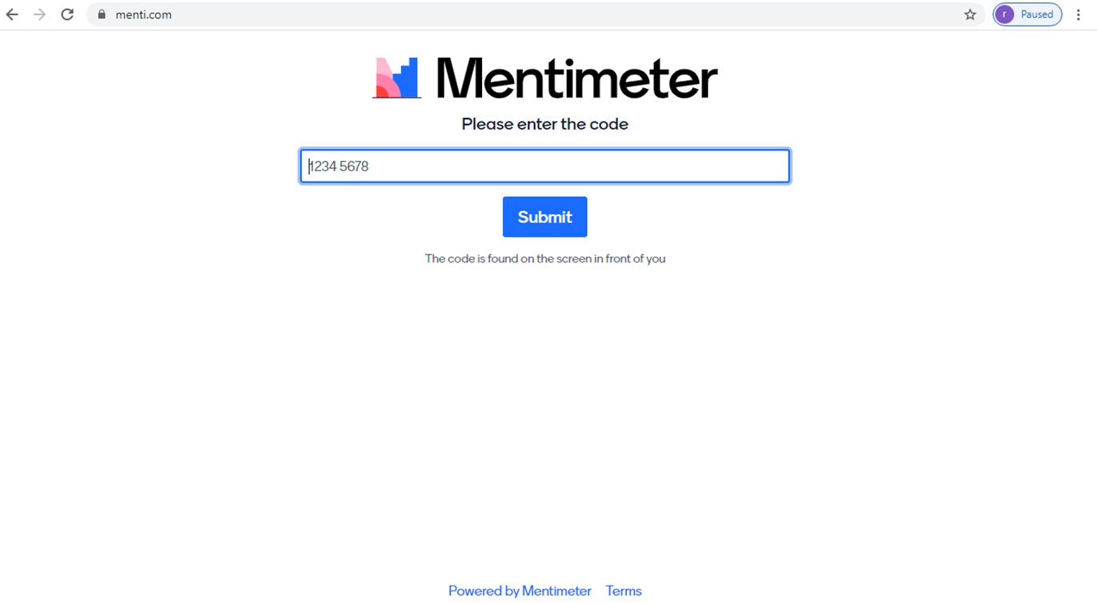
MENTIMETER

Slide 27
conclusion
As mentimeter is a student response system or an audience response system, so it allows students to give respond to the educator’s questions. This can ease the educator to measure the students’ understanding on the lesson learnt. This tool allows students to give opinions without hesitation because it is anonymous. The most importantly, it can be an option for the educators to create contents of online teaching and boost the students’ creativity by responding to the educators’ stimulant.

Slide 28
Thank you rachmisuryadi@gmail.com rachmisuryadi@stitmugu.ac.id

